Slide 1
XML for Android
Joesph Olliff

Slide 2
What is XML?
eXtensable Markup Language
Similar to HTML in that it performs no logic
Used to store static resources in an organized manner that is independent of any application that may access the information

Slide 3
How does XML work?
XML only has a handful of requirements to its layout. This is both a strength and a weakness
All XML files must begin with <?xml version=“1.0” encoding=“utf-8”?>
The XML document is a collection of Nodes that either contain further children nodes or some form of text
Remember the purpose of XML is store static resources in a well organized manner for other applications to use.

Slide 4
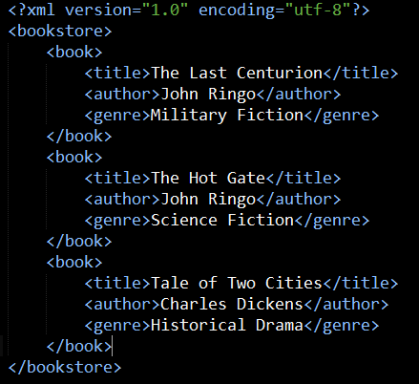
Example XML Document

Slide 5
Example Explained
//TODO: Explain root Node, and children nodes.
//TODO: Point out that the only nodes that have attributes are the ones with plain text

Slide 6
How is XML used by Android
Store Application settings
AndroidManifest.xml contains your heading information that identifies your application and what libraries it needs to the Android OS.
To determine the layout and appearance of your User Interfaces (Activities)
Storage for any static resources, i.e. Help messages, notification text, etc..

